Slide 1
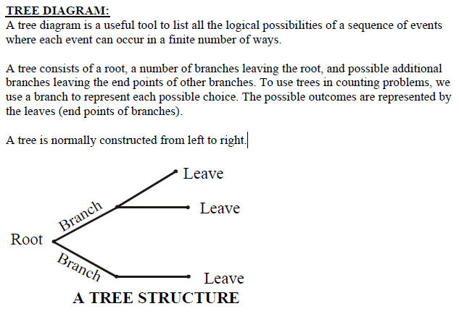
Lecture No.19 Tree Diagram

Slide 2
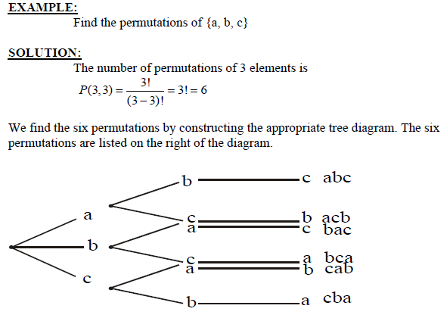

Slide 3
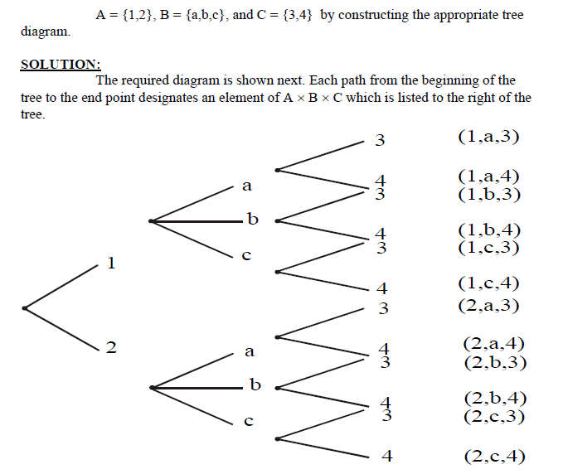
EXERCISE:
Find the product set A × B × C, where

Slide 4
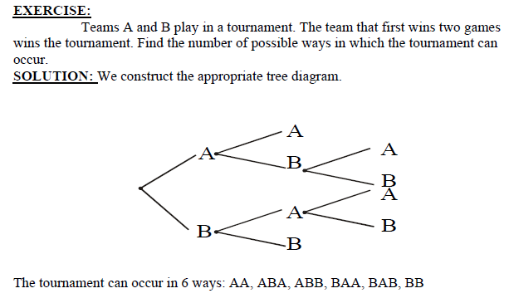

Slide 5
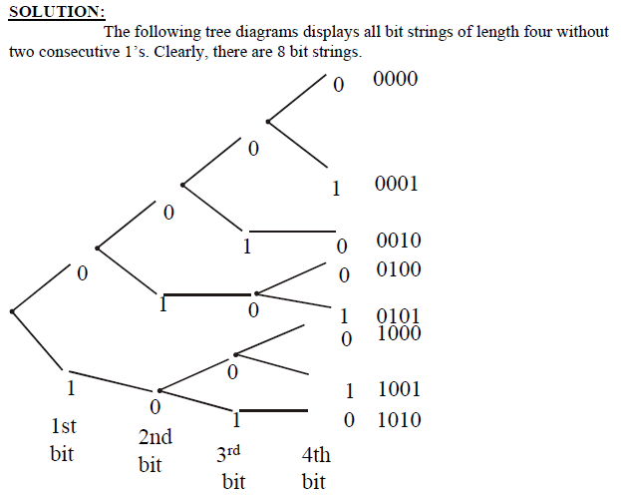
EXERCISE: How many bit strings of length four do not have two consecutive 1’s?

Slide 6
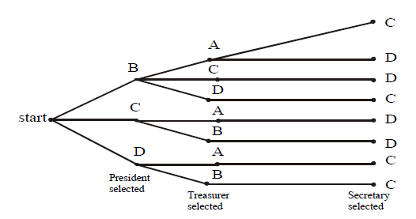
EXERCISE:
Three officers, a president, a treasurer, and a secretary are to be chosen from
among four possible: A, B, C and D. Suppose that A cannot be president and either C or D must be secretary.
How many ways can the officers be chosen?
SOLUTION:
We construct the possibility tree to see all the possible choices. From the tree given below, see that there are only eight ways possible to choose
the offices under given conditions.

Slide 7
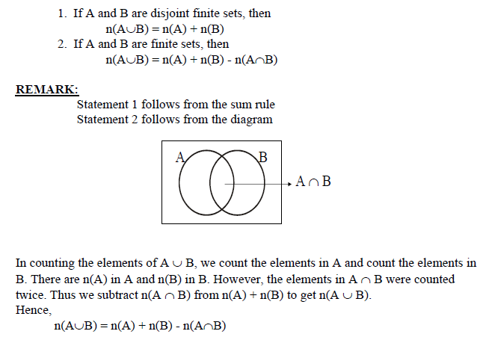
THE INCLUSION-EXCLUSION PRINCIPLE:

Slide 8
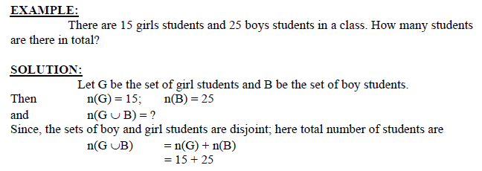

Slide 9
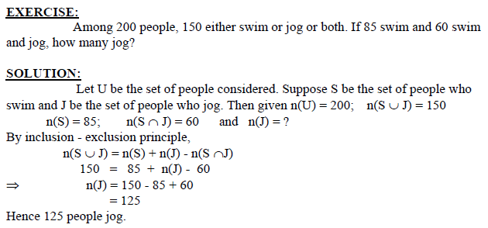

Slide 10
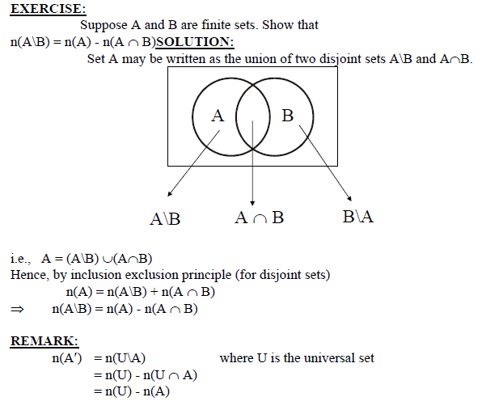

Slide 11
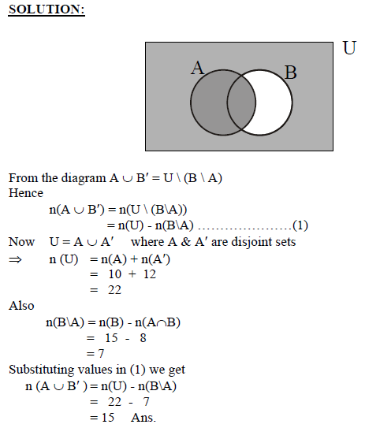
EXERCISE: Let A and B be subsets of U with n(A) = 10, n(B) = 15, n(A′)=12, and n(A∩B) = 8. Find n(A∪B′).

Slide 12
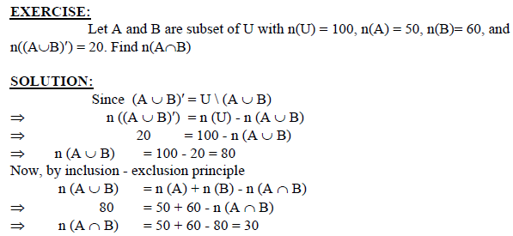

Slide 13
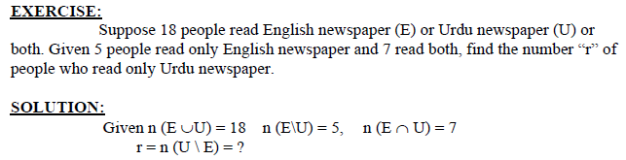
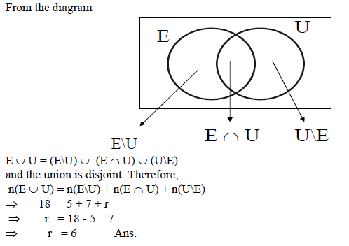

Slide 14
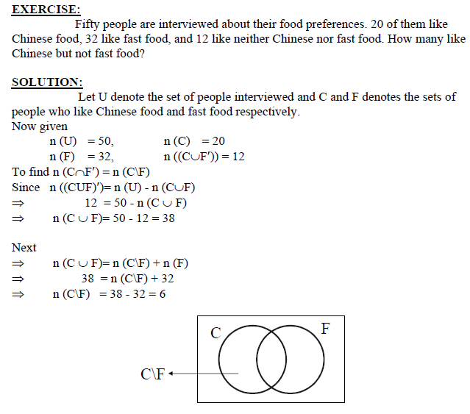

Slide 15
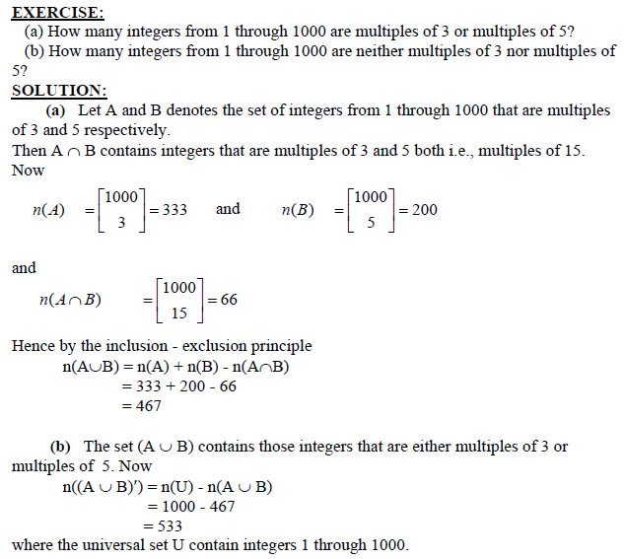
INCLUSION-EXCLUSION PRINCIPLE PIGEONHOLE PRINCIPLE

Slide 16
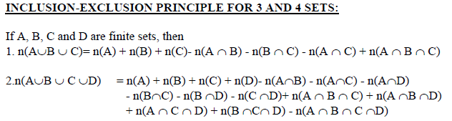

Slide 17
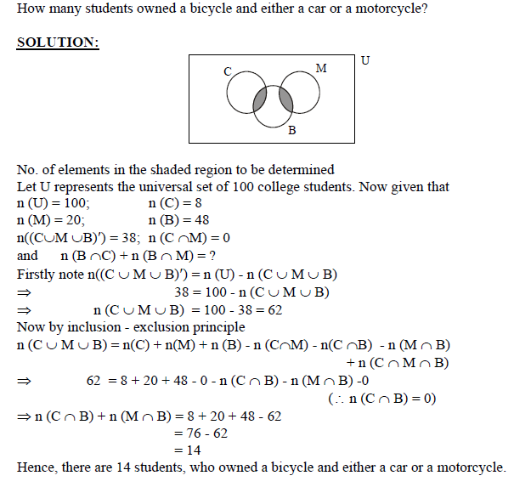
EXERCISE: A survey of 100 college students gave the following data: 8 owned a car (C) 20 owned a motorcycle (M) 48 owned a bicycle (B) 38 owned neither a car nor a motorcycle nor a bicycle No student who owned a car, owned a motorcycle

Slide 18
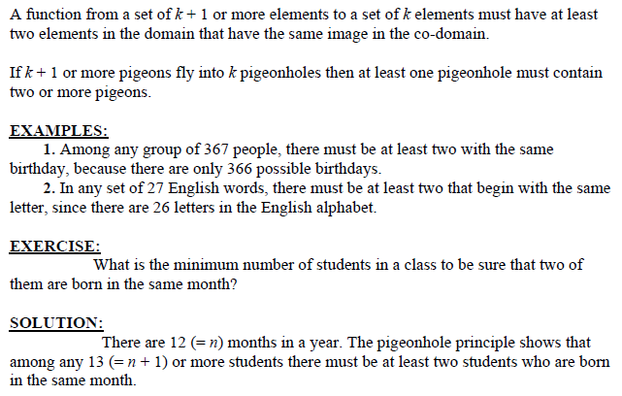
PIGEONHOLE PRINCIPLE

Slide 19
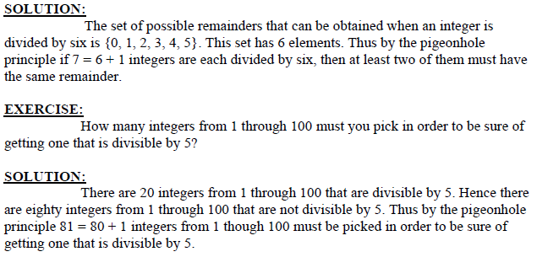
EXERCISE:
Given any set of seven integers, must there be two that have the same remainder when divided by 6?

Slide 20
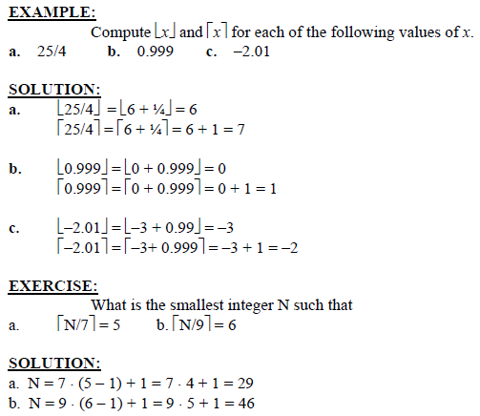
DEFINITION:
1. Given any real number x, the floor of x, denoted ⎣x⎦, is the largest integer smaller than or equal to x.
2. Given any real number x, the ceiling of x, denoted ⎡x⎤, is the smallest integer greater than or equal to x.

Slide 21
